Slide 1
VEGETABLE IMAGE CLASSIFICATION
INTRO TO INTELLIGENT SYSTEMS
ENGR-E 503
Sri Rashmitha Boya
Shyam Kumar Kanuru
Ritwik Budhiraja
INDIANA UNIVERSITY BLOOMINGTON

Slide 2
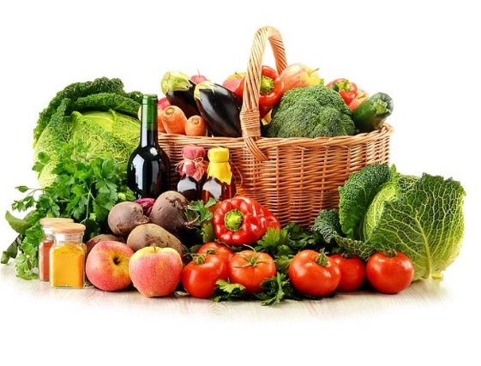
OVERVIEW
Abstract
Motivation
Dataset
Approach
Modelling and Results
Conclusion
Future work
Demo

Slide 3
ABSTRACT
SECTION:1

Slide 4
ABSTRACT
A vegetable production cycle generally includes selecting and sorting vegetables, labelling them, and putting them on the shelves. Such typical tasks are usually carried out manually. There has been an uprising demand for automating these processes. Our model presents an introductory step to achieving the goal of removing such tedious efforts. We have built deep learning models which will use multiple hidden layers to classify images as the correct vegetables. This model can be further used as the building steps for various applications.

Slide 5
MOTIVATION
SECTION:2

Slide 6
MOTIVATION
Amazon recently introduced a smart grocery store which uses the concept of a smart shopping cart.
The Amazon dash cart uses computer vision algorithms and camera sensors to automatically detect the items being put in the cart and then upload the prices of these items in the virtual cart.
This application prompted us to select a vegetable dataset and build an introductory algorithm to label of vegetables correctly.
We can then expand on this idea to jump deeper into classifying 3-D objects too.

Slide 7
DATASET
SECTION: 3

Slide 8
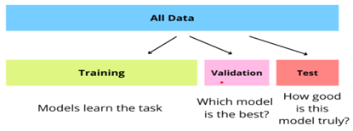
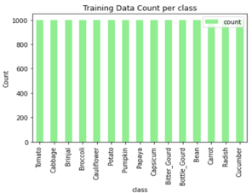
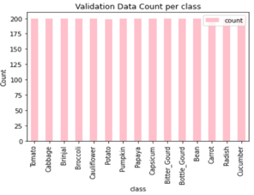
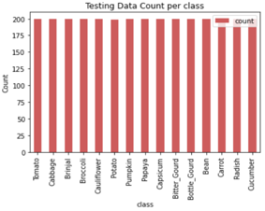
DATASET
The Dataset contains three folders:
Train(15000 images)
Validation(3000 images)
Test(3000 images)
Also added few custom pictures, to test the models(but only for few classes.)

Slide 9
APPROACH
SECTION:4

Slide 10
EDA
Baseline
CNN
Inc Layers
Data Preprocessing
Adding
BN, DR
Modelling
VGG16
Testing
Transfer
Learning
ResNet
Evaluation
MobileNet

Slide 11
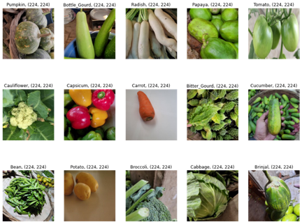
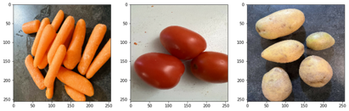
EDA and Preprocessing
We have 15 types of common vegetable classes in our data set.
Data Preprocessing Layers:
Image Resizing
Image Rescaling
Image Augmentation
Random Flip
Random Rotation

Slide 12
MODELLING
SECTION:5

Slide 13
CNN Models
Models used
CNN (Baseline with one ConV Layer)
Improved CNN - With Added Layers
Adding Batch Norm and Dropout Layers

Slide 14
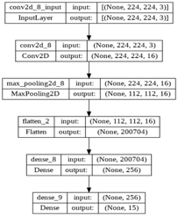
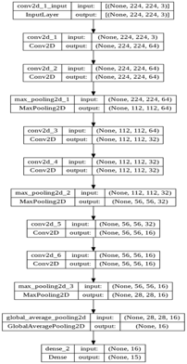
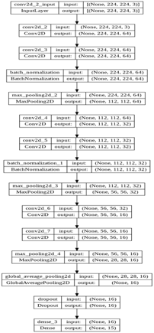
CNN Baseline With Added Layers Using BN and Dropout

Slide 15
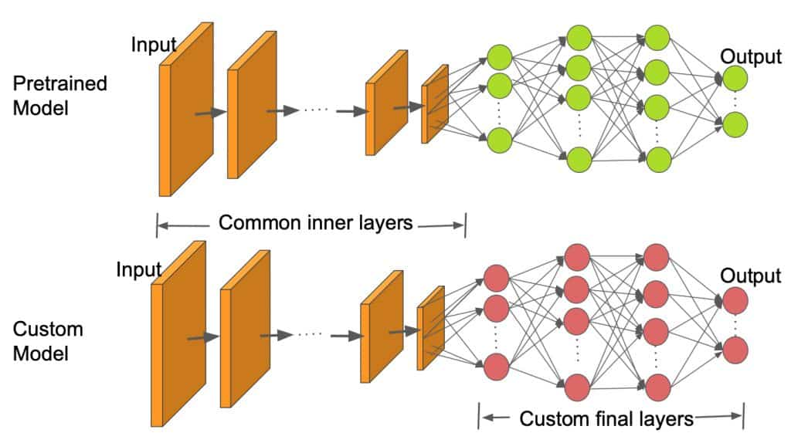
Transfer Learning
Why Transfer Learning ?
How we trained ?
Models used
Vgg16
ResNet
MobileNet

Slide 16
RESULTS
SECTION:6

Slide 17
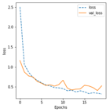
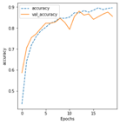
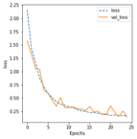
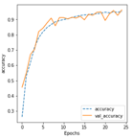
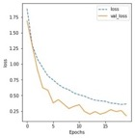
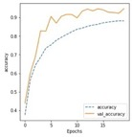
Model | Loss Curve | Accuracy Curve
CNN Baseline
CNN Improved
Using Batch Norm and Dropout Layers

Slide 18
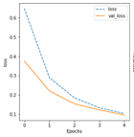
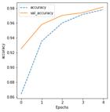
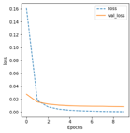
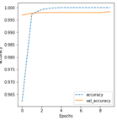
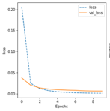
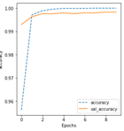
Model | Loss Curve | Accuracy Curve
VGG16
ResNet
MobileNet

Slide 19
MODEL | TRAIN ACCURACY | TEST ACCURACY | TRAINABLE PARAMETERS | OVERFITTING | CUSTOM ACCURACY
CNN | 89.65 | 82.13 | 51,384,783 | Yes | 30.32
CNN Inc layers | 95.30 | 90.23 | 73,631 | Yes | 35.69
CNN with Dropout and Batch Normalization | 87.79 | 88.28 | 73,823 | No | 21.24
VGG16 | 97.80 | 98.10 | 33,807 | No | 63.64
ResNet | 98.23 | 98.20 | 30,735 | No | 93.94
MobileNet | 98.37 | 98.90 | 19,215 | No | 87.88

Slide 20
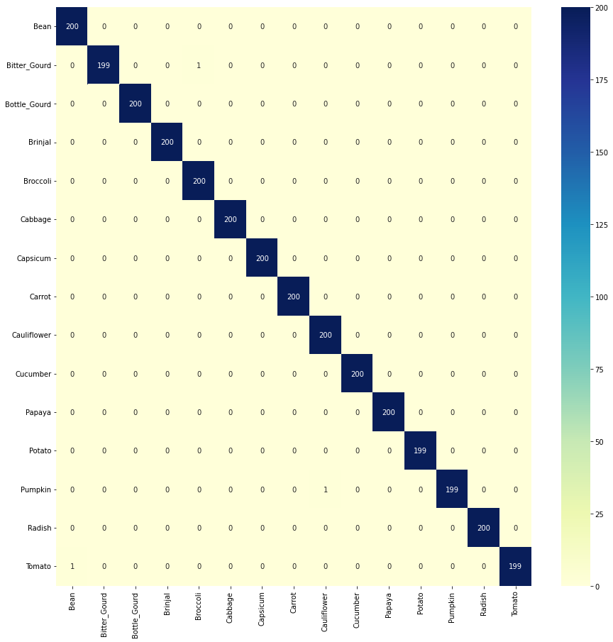
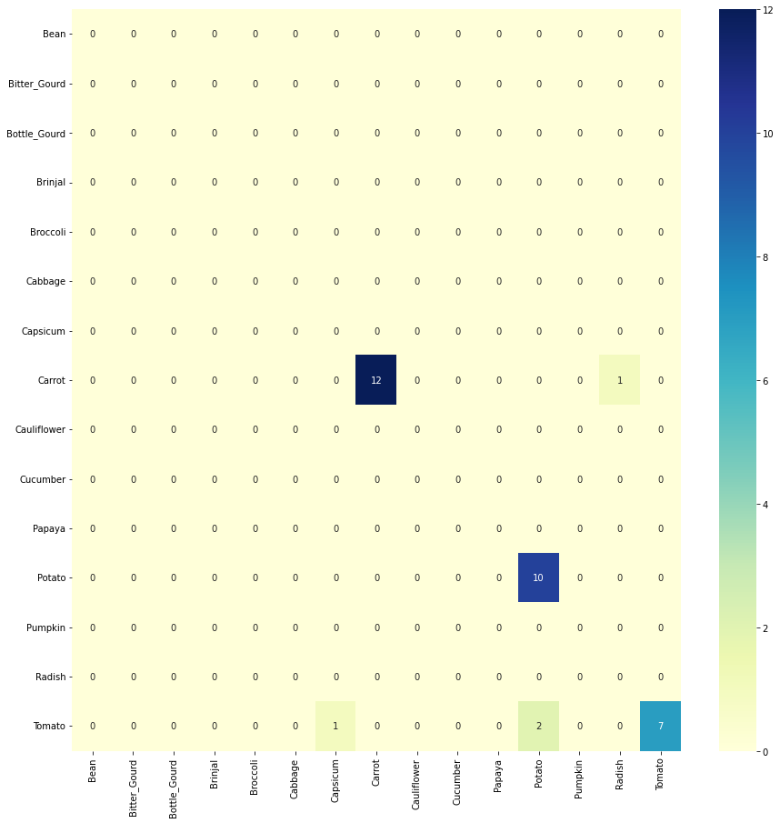
MobileNet Confusion Matrix
RESULTS

Slide 21
CONCLUSION
SECTION:7

Slide 22
CONCLUSION
Transfer learning methods gives us better results than the traditional CNN.
Pre-trained CNN architectures perform better even on small datasets when compared to the baseline CNN Models.

Slide 23
FUTURE SCOPE
SECTION:8

Slide 24
Future Scope
This project can be used as the basis to move to objects from images. That would require working with different sensors and exploring some IoT (Internet of Things) ideas.
Images of rotten vegetables can also be added to the dataset, which can be then used to segregate such products from the fresh ones.

Slide 25
REFERENCES
SECTION:9

Slide 26
REFERENCES
https://www.researchgate.net/publication/352846889_DCNN-Based_Vegetable_Image_Classification_Using_Transfer_Learning_A_Comparative_Study
https://arxiv.org/abs/1512.03385
https://www.kaggle.com/datasets/misrakahmed/vegetable-image-dataset?datasetId=1817999&sortBy=voteCount
http://vision.stanford.edu/documents/DengBergLiFei-Fei_ECCV2010.pdf
https://www.tensorflow.org/tutorials/images/classification
https://medium.com/edureka/tensorflow-image-classification-19b63b7bfd95

Slide 27
DEMO
SECTION:10

Slide 28
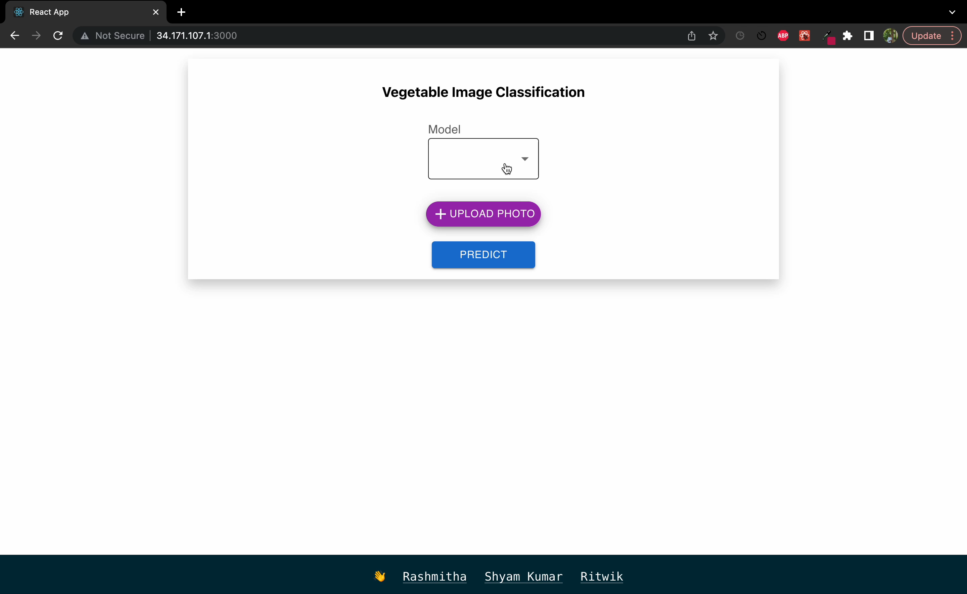

Slide 29
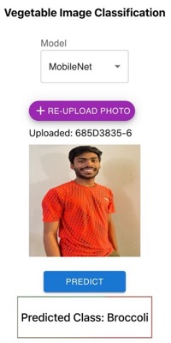
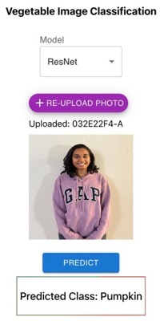
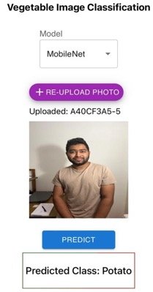
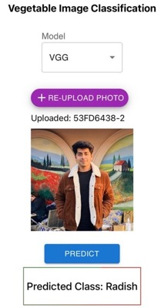

Slide 30

Try Me!

